Slide 1

Introduction to Probability and Statistics
Twelfth Edition
Robert J. Beaver • Barbara M. Beaver • William Mendenhall
Presentation designed and written by:
Barbara M. Beaver

Slide 2
Introduction to Probability and Statistics
Twelfth Edition
Chapter 10
Inference from
Small Samples
Some graphic screen captures from Seeing Statistics ®
Some images © 2001-(current year) www.arttoday.com

Slide 3

Introduction
When the sample size is small, the estimation and testing procedures of Chapter 8 are not appropriate.
There are equivalent small sample test and estimation procedures for
  μ, the mean of a normal population
  μ₁−μ₂, the difference between two population means
  σ², the variance of a normal population
  The ratio of two population variances.

Slide 4
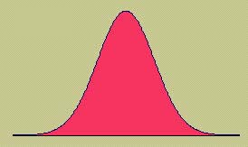

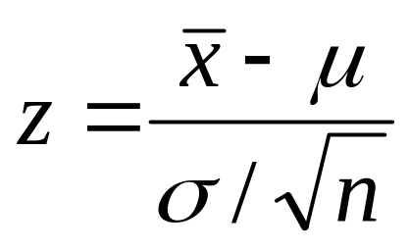
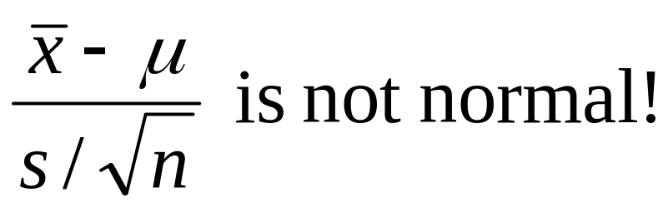
The Sampling Distribution of the Sample Mean
When we take a sample from a normal population, the sample mean has a normal distribution for any sample size n, and
has a standard normal distribution.
But if σ is unknown, and we must use s to estimate it, the resulting statistic is not normal.

Slide 5
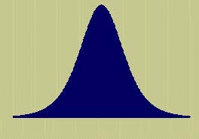
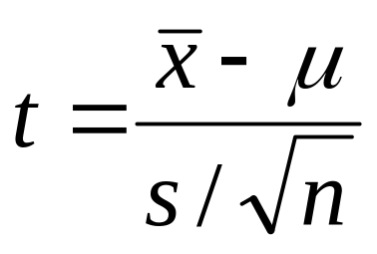
Student’s t Distribution
Fortunately, this statistic does have a sampling distribution that is well known to statisticians, called the Student’s t distribution, with n-1 degrees of freedom.
We can use this distribution to create estimation testing procedures for the population mean μ.

Slide 6
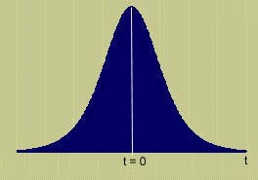
Properties of Student’s t
Mound-shaped and symmetric about 0.
More variable than z, with “heavier tails”
Shape depends on the sample size n or the degrees of freedom, n-1.
As n increases the shapes of the t and z distributions become almost identical.
MY
APPLET

Slide 7
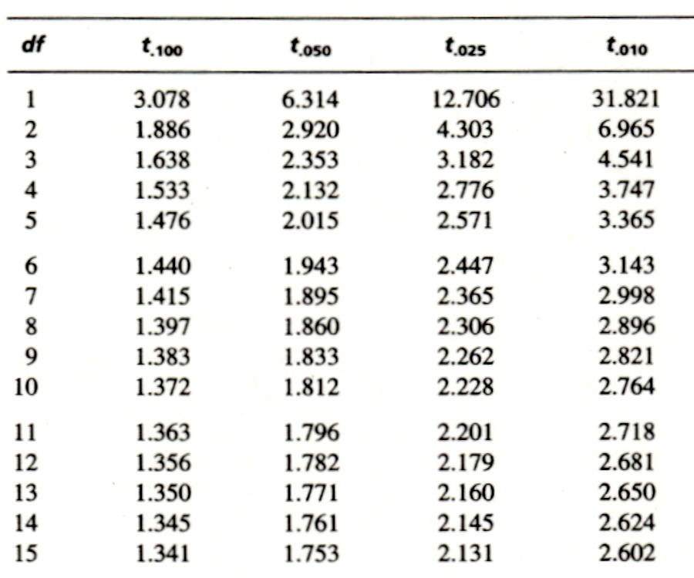
Using the t-Table
Table 4 gives the values of t that cut off certain critical values in the tail of the t distribution.
Index df and the appropriate tail area a to find t_{a},the value of t with area a to its right.
For a random sample of size n = 10, find a value of t that cuts off .025 in the right tail.
Row = df = n –1 = 9
Column subscript = a = .025
t_{.025} = 2.262

Slide 8
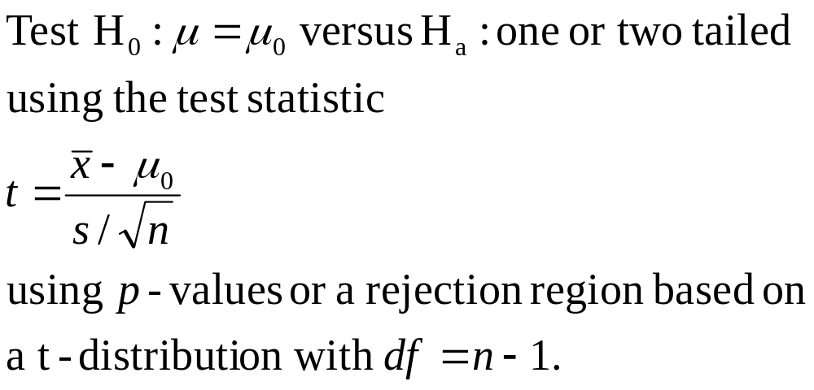
Small Sample Inference for a Population Mean μ
The basic procedures are the same as those used for large samples. For a test of hypothesis:

Slide 9
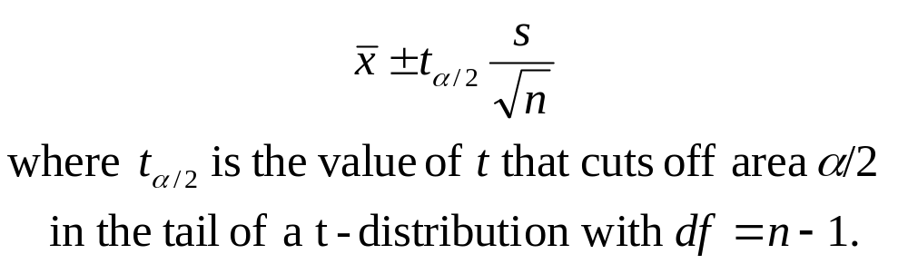
Small Sample Inference for a Population Mean μ
For a 100(1−α)% confidence interval for the population mean μ:

Slide 10

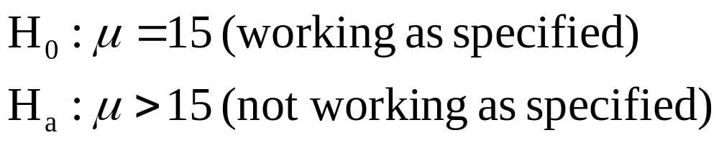
Example
A sprinkler system is designed so that the average time for the sprinklers to activate after being turned on is no more than 15 seconds. A test of 5 systems gave the following times:
  17, 31, 12, 17, 13, 25
  Is the system working as specified? Test using
  α = .05.

Slide 11
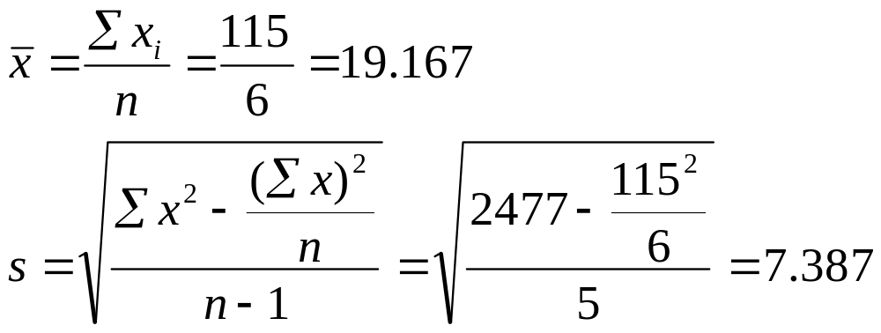
Example
Data: 17, 31, 12, 17, 13, 25
First, calculate the sample mean and standard deviation, using your calculator or the formulas in Chapter 2.

Slide 12
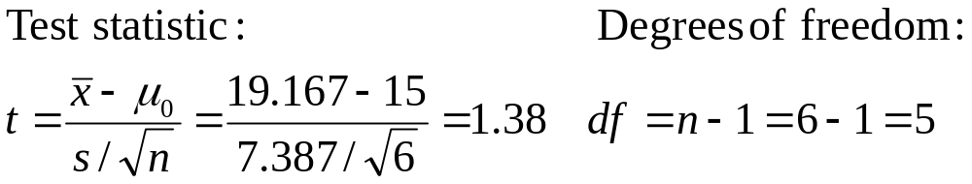
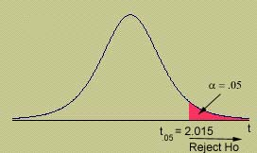
Example
Data: 17, 31, 12, 17, 13, 25
Calculate the test statistic and find the rejection region for α =.05.
Rejection Region: Reject H₀ if t > 2.015. If the test statistic falls in the rejection region, its p-value will be less than α = .05.

Slide 13
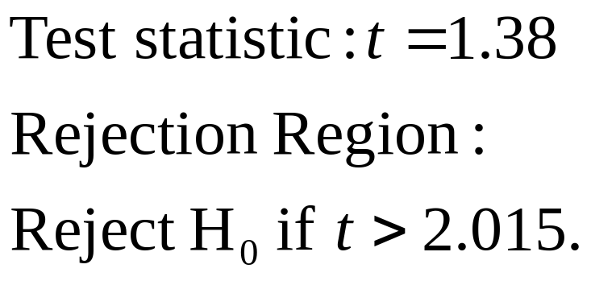
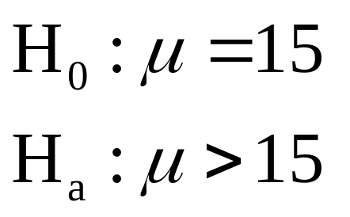
Conclusion
Data: 17, 31, 12, 17, 13, 25
Compare the observed test statistic to the rejection region, and draw conclusions.
Conclusion: For our example, t = 1.38 does not fall in the rejection region and H₀ is not rejected. There is insufficient evidence to indicate that the average activation time is greater than 15.

Slide 14
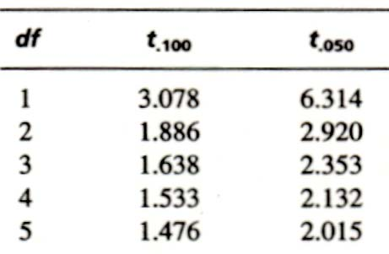
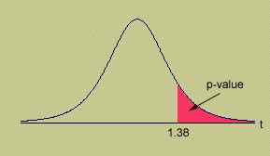
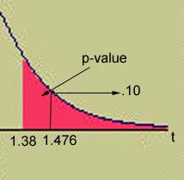
Approximating the p-value
You can only approximate the p-value for the test using Table 4.
Since the observed value of t = 1.38 is smaller than t_{.10} = 1.476,
p-value > .10.

Slide 15
The exact p-value
MY
APPLET
You can get the exact p-value
using some calculators or a computer.
p-value = .113 which is greater than .10 as we approximated using Table 4.
One-Sample T: Times
Test of mu = 15 vs > 15
95%
Lower
Variable N Mean StDev SE Mean Bound T P
Times 6 19.1667 7.3869 3.0157 13.0899 1.38 0.113

Slide 16
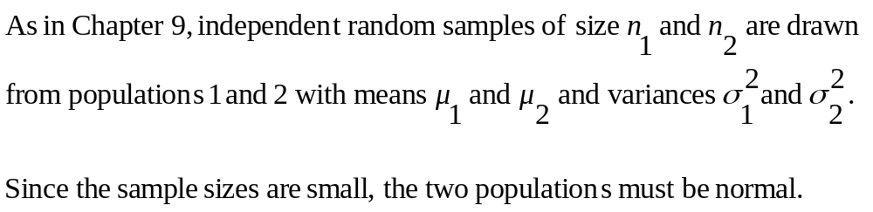
Testing the Difference between Two Means
  To test:
    H₀: μ₁−μ₂ = D₀ versus H_{a}: one of three
  where D₀ is some hypothesized difference, usually 0.

Slide 17
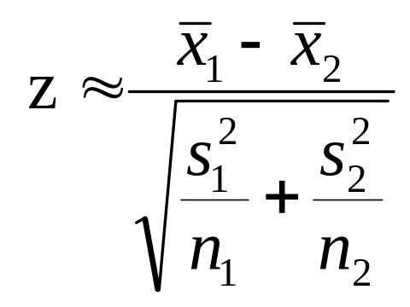
Testing the Difference between Two Means
  The test statistic used in Chapter 9
  does not have either a z or a t distribution, and cannot be used for small-sample inference.
  We need to make one more assumption, that the population variances, although unknown, are equal.

Slide 18
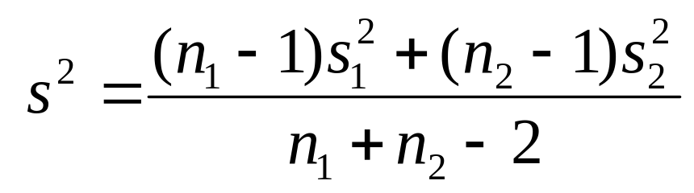
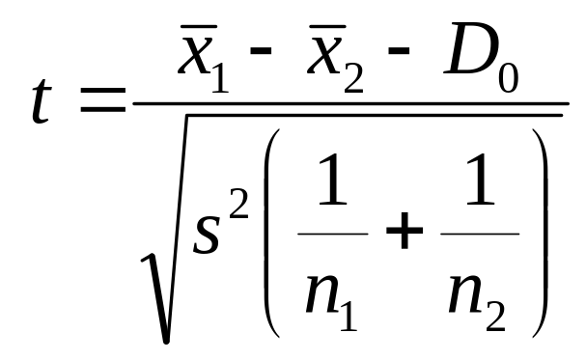
Testing the Difference between Two Means
  Instead of estimating each population variance separately, we estimate the common variance with
And the resulting test statistic,
has a t distribution with n₁+n₂-2 degrees of freedom.

Slide 19
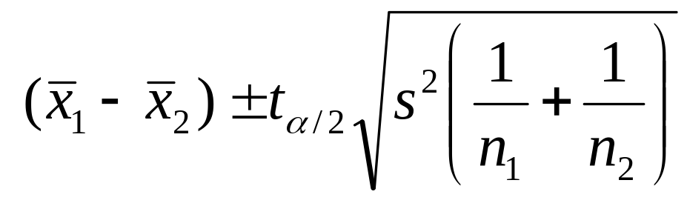
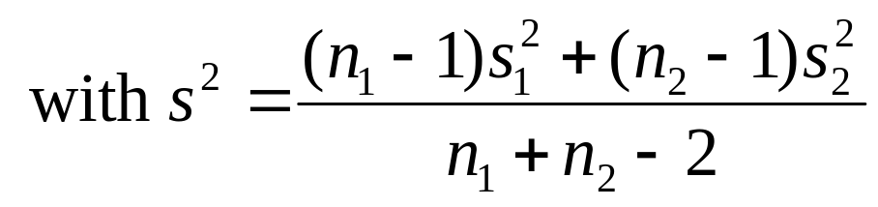
Estimating the Difference between Two Means
  You can also create a 100(1-α)% confidence interval for μ₁-μ₂.
Remember the three assumptions:
Original populations normal
Samples random and independent
Equal population variances.

Slide 20

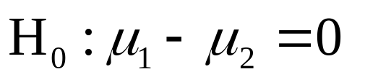
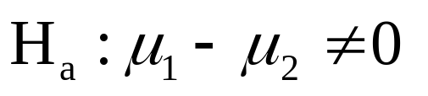
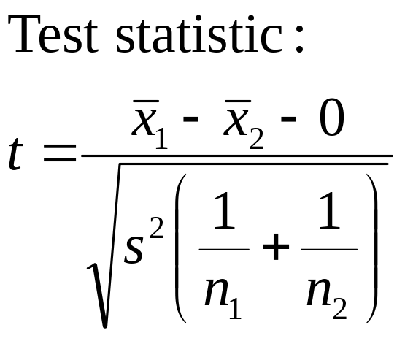
Example
Two training procedures are compared by
measuring the time that it takes trainees to
assemble a device. A different group of trainees are taught using each method. Is there a difference in the two methods? Use α = .01.
Time to Assemble | Method 1 | Method 2
Sample size | 10 | 12
Sample mean | 35 | 31
Sample Std Dev | 4.9 | 4.5

Slide 21
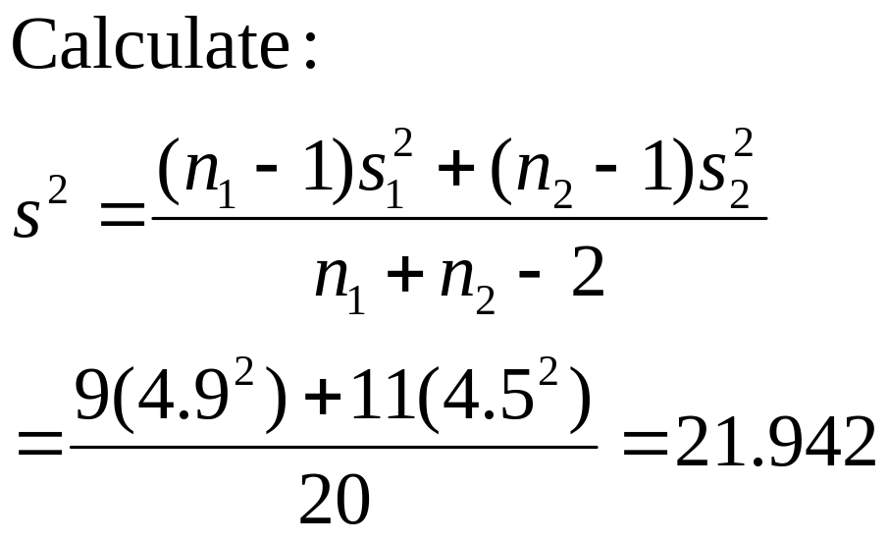
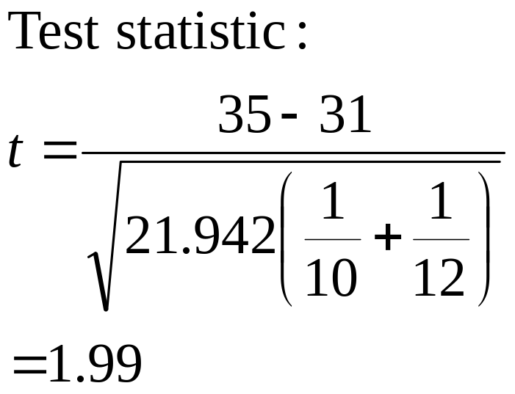
Example
MY
APPLET
Solve this problem by approximating the p-value using
Table 4.
Time to Assemble | Method 1 | Method 2
Sample size | 10 | 12
Sample mean | 35 | 31
Sample Std Dev | 4.9 | 4.5

Slide 22
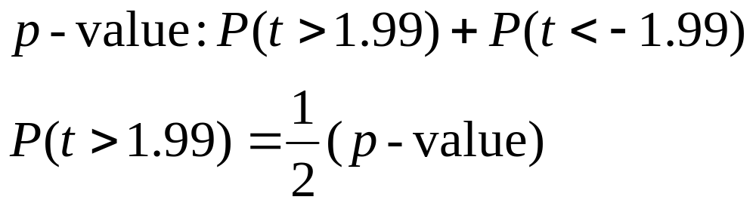
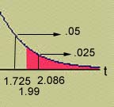
Example
df = n₁ + n₂ – 2 = 10 + 12 – 2 = 20
.025 < ½( p-value) < .05
.05 < p-value < .10
Since the p-value is greater than α = .01, H₀ is not rejected. There is insufficient evidence to indicate a difference in the population means.

Slide 23
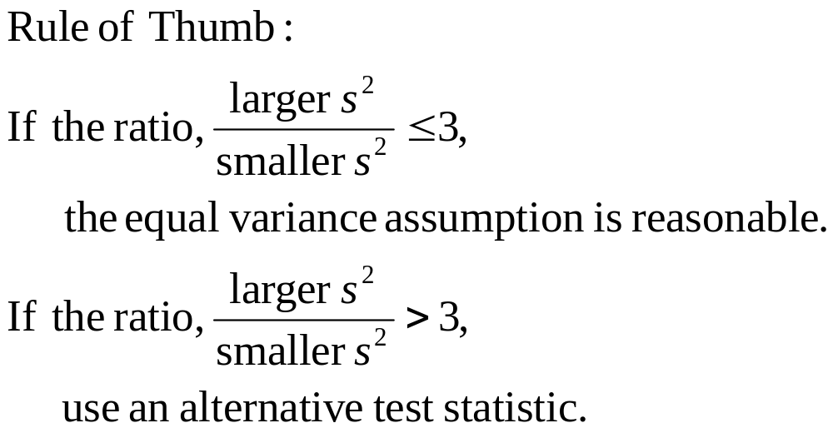
Testing the Difference between Two Means
  How can you tell if the equal variance assumption is reasonable?

Slide 24
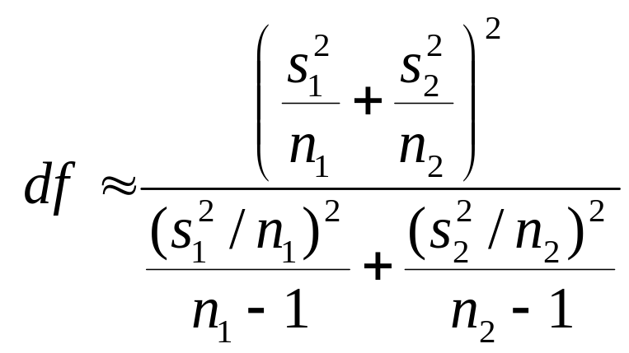
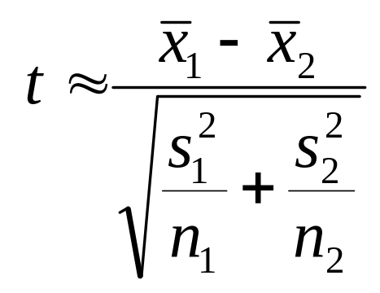
Testing the Difference between Two Means
  If the population variances cannot be assumed equal, the test statistic
  has an approximate t distribution with degrees of freedom given above. This is most easily done by computer.

Slide 25
The Paired-Difference
Test
Sometimes the assumption of independent samples is intentionally violated, resulting in a matched-pairs or paired-difference test.
By designing the experiment in this way, we can eliminate unwanted variability in the experiment by analyzing only the differences,
    d_{i} = x_{1i} – x_{2i}
to see if there is a difference in the two population means, μ₁−μ₂.

Slide 26

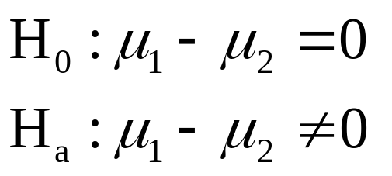
Example
Car | 1 | 2 | 3 | 4 | 5
Type A | 10.6 | 9.8 | 12.3 | 9.7 | 8.8
Type B | 10.2 | 9.4 | 11.8 | 9.1 | 8.3
One Type A and one Type B tire are randomly assigned to each of the rear wheels of five cars. Compare the average tire wear for types A and B using a test of hypothesis.
But the samples are not independent. The pairs of responses are linked because measurements are taken on the same car.

Slide 27
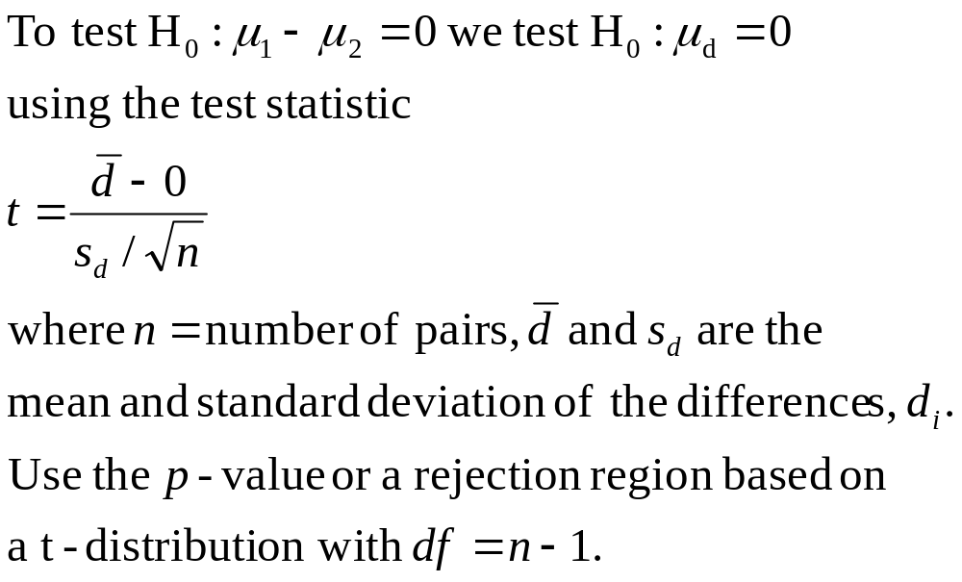
The Paired-Difference
Test

Slide 28
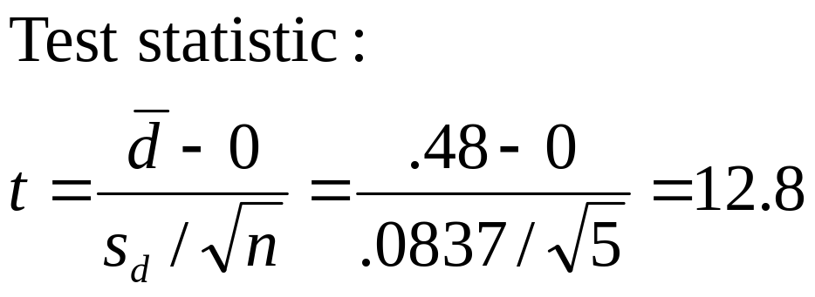
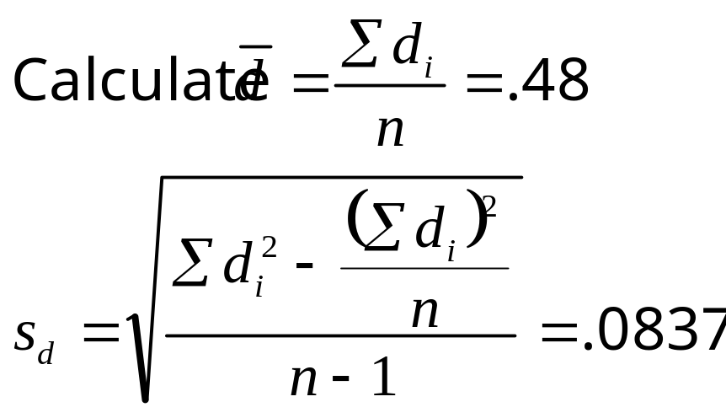
Example
Car | 1 | 2 | 3 | 4 | 5
Type A | 10.6 | 9.8 | 12.3 | 9.7 | 8.8
Type B | 10.2 | 9.4 | 11.8 | 9.1 | 8.3
Difference | .4 | .4 | .5 | .6 | .5

Slide 29
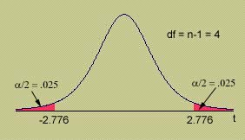
Example
Car | 1 | 2 | 3 | 4 | 5
Type A | 10.6 | 9.8 | 12.3 | 9.7 | 8.8
Type B | 10.2 | 9.4 | 11.8 | 9.1 | 8.3
Difference | .4 | .4 | .5 | .6 | .5
Rejection region: Reject H₀ if t > 2.776 or t < -2.776.
Conclusion: Since t = 12.8, H₀ is rejected. There is a difference in the average tire wear for the two types of tires.

Slide 30
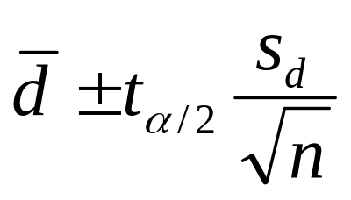
Some Notes
You can construct a 100(1-α)% confidence interval for a paired experiment using
Once you have designed the experiment by pairing, you MUST analyze it as a paired experiment. If the experiment is not designed as a paired experiment in advance, do not use this procedure.

Slide 31
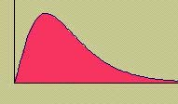
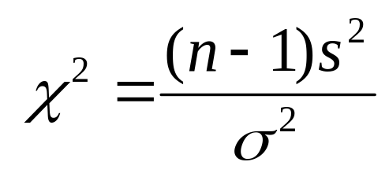
Inference Concerning a Population Variance
  Sometimes the primary parameter of interest is not the population mean μ but rather the population variance σ². We choose a random sample of size n from a normal distribution.
  The sample variance s² can be used in its standardized form:
  which has a Chi-Square distribution with n - 1 degrees of freedom.

Slide 32
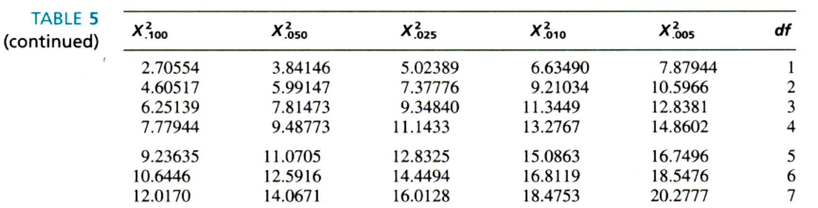
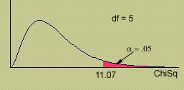
Inference Concerning a Population Variance
  Table 5 gives both upper and lower critical values of the chi-square statistic for a given df.
For example, the value of chi-square that cuts off .05 in the upper tail of the distribution with df = 5 is χ² =11.07.

Slide 33
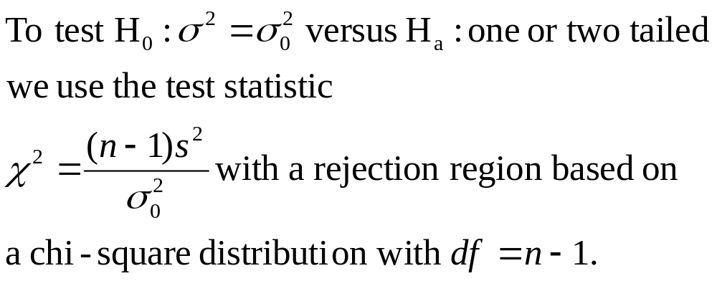
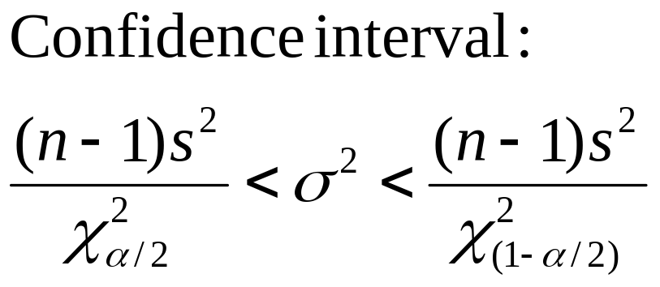
Inference Concerning a Population Variance

Slide 34

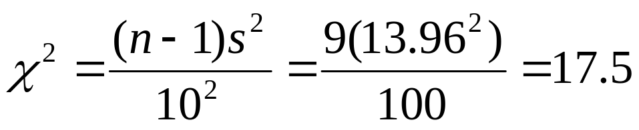
Example
  A cement manufacturer claims that his cement has a compressive strength with a standard deviation of 10 kg/cm² or less. A sample of n = 10 measurements produced a mean and standard deviation of 312 and 13.96, respectively.
A test of hypothesis:
H₀: σ² = 10 (claim is correct)
H_{a}: σ² > 10 (claim is wrong)
uses the test statistic:

Slide 35
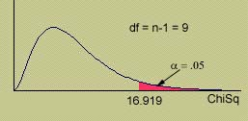
Example
  Do these data produce sufficient evidence to reject the manufacturer’s claim? Use α = .05.
Rejection region: Reject H₀ if χ² > 16.919 (α = .05).
Conclusion: Since χ²= 17.5, H₀ is rejected. The standard deviation of the cement strengths is more than 10.

Slide 36

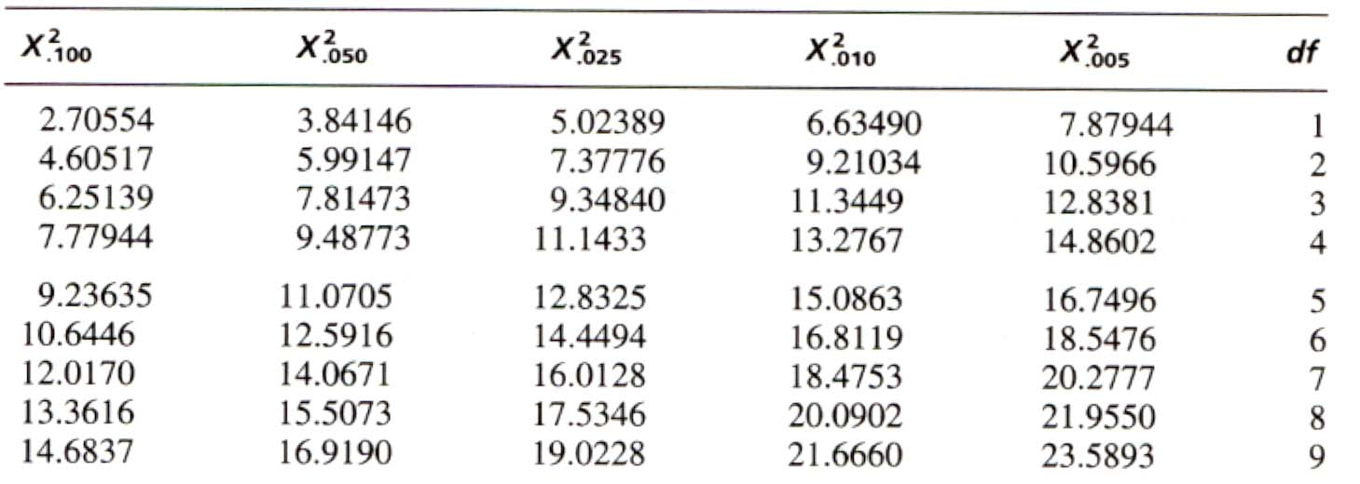
Approximating the p-value
.025 < p-value < .05
Since the p-value is less than α = .05, H₀ is not rejected. There is sufficient evidence to reject the manufacturer’s claim.

Slide 37
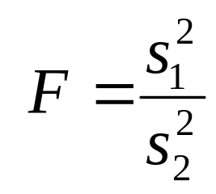
Inference Concerning
Two Population Variances
  We can make inferences about the ratio of two population variances in the form a ratio. We choose two independent random samples of size n₁ and n₂ from normal distributions.
  If the two population variances are equal, the statistic
  has an F distribution with df₁ = n₁ - 1 and df₂ = n₂ - 1 degrees of freedom.

Slide 38

Inference Concerning
Two Population Variances
  Table 6 gives only upper critical values of the F statistic for a given pair of df₁ and df₂.
For example, the value of F that cuts off .05 in the upper tail of the distribution with df₁ = 5 and df₂ = 8 is F =3.69.

Slide 39


Inference Concerning
Two Population Variances

Slide 40


Example
  An experimenter has performed a lab experiment using two groups of rats. He wants to test H₀: μ₁ = μ₂, but first he wants to make sure that the population variances are equal.
 | Standard (2) | Experimental (1)
Sample size | 10 | 11
Sample mean | 13.64 | 12.42
Sample Std Dev | 2.3 | 5.8

Slide 41


Example
 | Standard (2) | Experimental (1)
Sample size | 10 | 11
Sample Std Dev | 2.3 | 5.8
We designate the sample with the larger standard deviation as sample 1, to force the test statistic into the upper tail of the F distribution.

Slide 42
Example
The rejection region is two-tailed, with α = .05, but we only need to find the upper critical value, which has α/2 = .025 to its right.
From Table 6, with df₁=10 and df₂ = 9, we reject H₀ if F > 3.96.
CONCLUSION: Reject H₀. There is sufficient evidence to indicate that the variances are unequal. Do not rely on the assumption of equal variances for your t test!

Slide 43
Key Concepts
I. Experimental Designs for Small Samples
1. Single random sample: The sampled population must be normal.
2. Two independent random samples: Both sampled populations must be normal.
a. Populations have a common variance σ ².
b. Populations have different variances
3. Paired-difference or matched-pairs design: The samples are not independent.

Slide 44
Key Concepts
II. Statistical Tests of Significance
1. Based on the t, F, and χ ² distributions
2. Use the same procedure as in Chapter 9
3. Rejection region — critical values and significance levels:
based on the t, F, and χ ² distributions with the appropriate
degrees of freedom
4. Tests of population parameters: a single mean, the difference between two means, a single variance, and the ratio of two variances
III. Small Sample Test Statistics
To test one of the population parameters when the sample sizes are small, use the following test statistics:

Slide 45

Key Concepts

